Slide 1

CSC 533: Privacy in the Digital Age (Fall 2020) Lecture 25: Acoustic and Motion sensor based side-channels
Anupam Das
Nov. 12, 2020

Slide 2
Goals for today
Inference attacks based on:
Acoustic side channels
keystroke
3D printed object
inaudible voice commands
Motion sensor based side channels
speech recognition
route/location
Some slide contents have been taken from Vitaly Shmatikov, Chen Song, Sheng Shen, Yan Michalevsky

Slide 3
Side Channels
A side-channel attack is any attack based on information gained from the physical implementation of a system (process), rather than theoretical weaknesses in the algorithms
Information is leaked unintentionally
Usually, through some shared resource

Slide 4
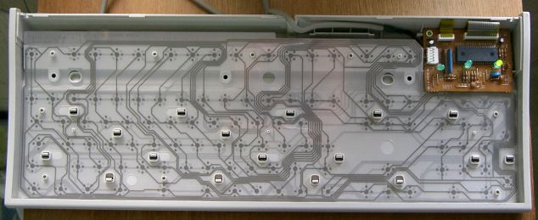
Acoustic Information in Typing
Different keystrokes make different sounds
Different locations on the supporting plate
Each key is slightly different
Frequency information in the sound of the typed key can be used to learn which key it is
Observed by Asonov and Agrawal (2004)

Slide 5
“Key” Observation
Build acoustic model for keyboard and typist
Exploit the fact that typed text is non-random (for example, English)
Limited number of words
Limited letter sequences (spelling)
Limited word sequences (grammar)
This requires a natural language model
[Zhuang et al. “Keyboard Acoustic Emanations Revisited”. CCS 2005]

Slide 6
Overview
[Zhuang, Zhou, Tygar]
Initial
training
Subsequent
recognition
wave signal
wave signal
(recorded sound)
Feature Extraction
Feature Extraction
Unsupervised Learning
Keystroke Classifier
Language Model Correction
Language Model Correction
(optional)
Sample Collector
Classifier Builder
keystroke classifier recovered keystrokes
recovered keystrokes

Slide 7
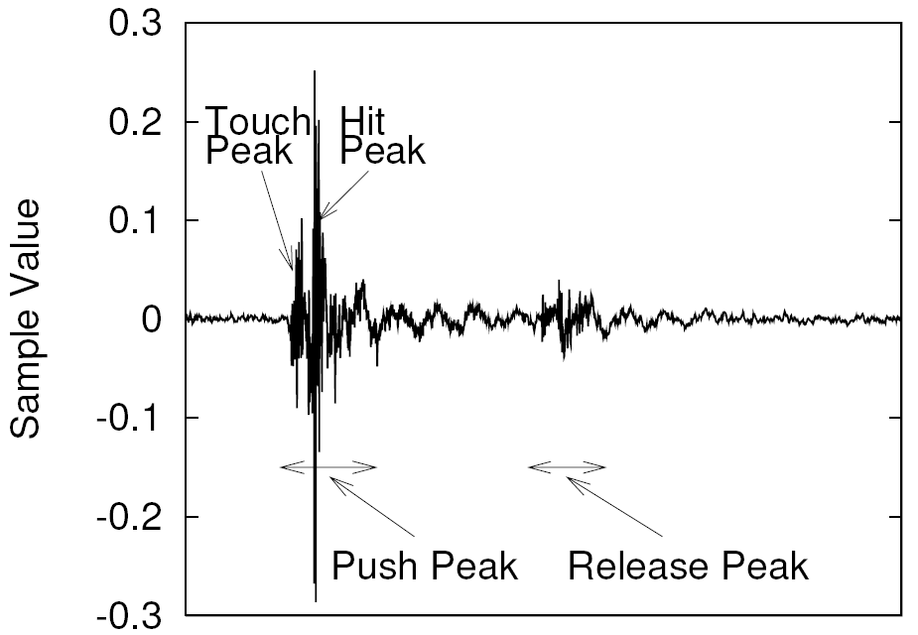
Sound of a Keystroke
[Zhuang, Zhou, Tygar]
Each keystroke is represented as a vector of spectral features
Fourier transform of the decibel spectrum
Standard technique from speech processing

Slide 8
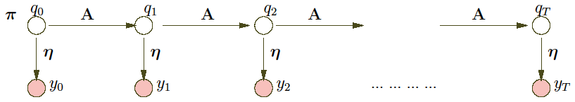
Bi-Grams of Characters
[Zhuang, Zhou, Tygar]
Group keystrokes into N clusters
Find the best mapping from cluster labels to characters
Exploit the fact that some 2-character combinations are more common than others
Example: “th” vs. “tj”
Hidden Markov Models (HMM) for unsupervised learning
“t”
“h”
“e”
5
11
2

Slide 9
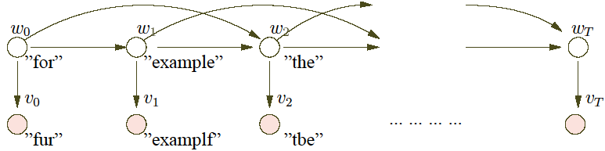
Spelling and Grammar
[Zhuang, Zhou, Tygar]
First, spelling correction
Then, simple statistical model of English grammar: common tri-grams of words
Use HMMs again to model

Slide 10
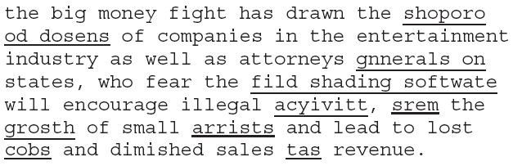
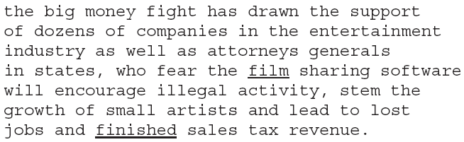
Recovered Text
[Zhuang, Zhou, Tygar]
Before spelling and grammar correction
After spelling and grammar correction
_____ = errors in recovery
= errors corrected by grammar

Slide 11
Feedback-based Training
[Zhuang, Zhou, Tygar]
Recovered characters + language correction provide feedback for more rounds of training
Output: keystroke classifier
Language-independent
Can be used to recognize random sequences of keys
For example, passwords
Many possible representations of keystroke classifier
Neural networks, linear classification, Gaussian mixtures

Slide 12
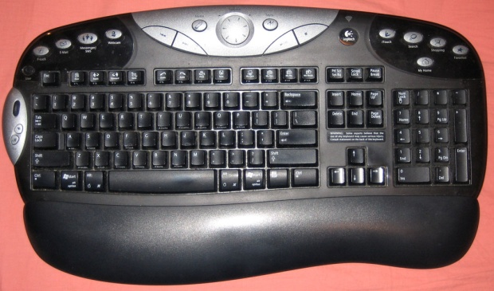
Experiment: Single Keyboard
[Zhuang, Zhou, Tygar]
Logitech Elite Duo
wireless keyboard
4 data sets recorded in
two settings: quiet and noisy
Consecutive keystrokes are clearly separable
Automatically extract keystroke positions in the signal with some manual error correction

Slide 13
Results for a Single Keyboard
[Zhuang, Zhou, Tygar]
Datasets
Initial and final recognition rate
 | Recording length | Number of words | Number of keys
Set 1 | ~12 min | ~400 | ~2500
Set 2 | ~27 min | ~1000 | ~5500
Set 3 | ~22 min | ~800 | ~4200
Set 4 | ~24 min | ~700 | ~4300
 | Set 1 (%) |  | Set 2 (%) |  | Set 3 (%) |  | Set 4 (%)
 | Word | Char | Word | Char | Word | Char | Word | Char
Initial | 35 | 76 | 39 | 80 | 32 | 73 | 23 | 68
Final | 90 | 96 | 89 | 96 | 83 | 95 | 80 | 92
Corrected after several rounds of feedback. E.g., using 4, 5, 7 and 10 minutes of data

Slide 14
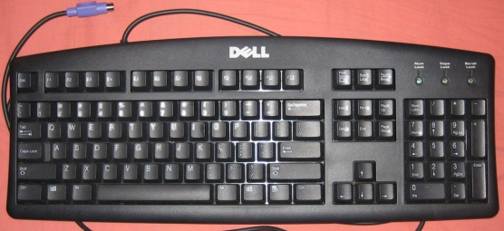
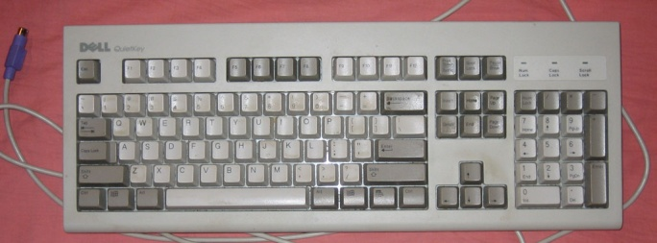
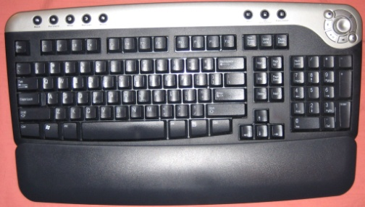
Experiment: Multiple Keyboards
[Zhuang, Zhou, Tygar]
Keyboard 1: Dell QuietKey PS/2
In use for about 6 months
Keyboard 2: Dell QuietKey PS/2
In use for more than 5 years
Keyboard 3: Dell Wireless Keyboard
New

Slide 15
Results for Multiple Keyboards
[Zhuang, Zhou, Tygar]
12-minute recording with app. 2300 characters
 | Keyboard 1 (%) |  | Keyboard 2 (%) |  | Keyboard 3 (%)
 | Word | Char | Word | Char | Word | Char
Initial | 31 | 72 | 20 | 62 | 23 | 64
Final | 82 | 93 | 82 | 94 | 75 | 90

Slide 16

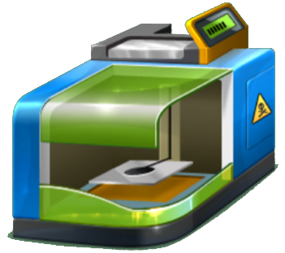
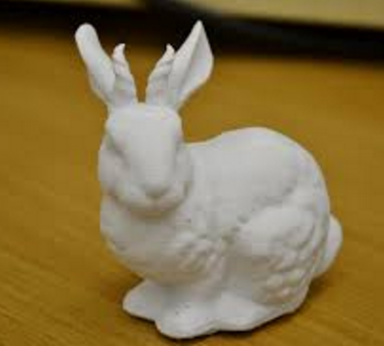
3D Printing
Cyber Design
3D Printing
Physical Object
16

Slide 17
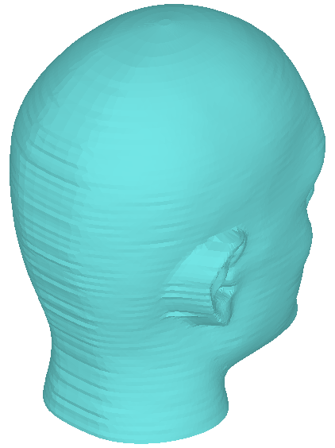
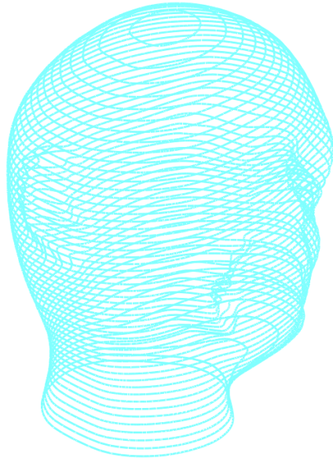


3D Printing Principle
Add layers of material one at a time to build the solid part from bottom to top
Design
Slicing
3D Printing
3D Printing => Structure-free

Slide 18
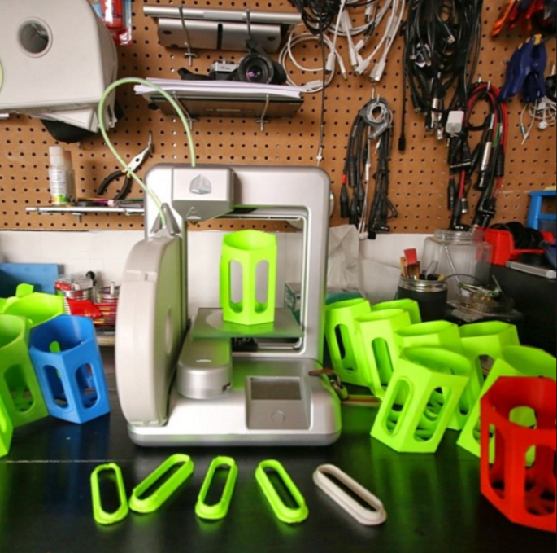
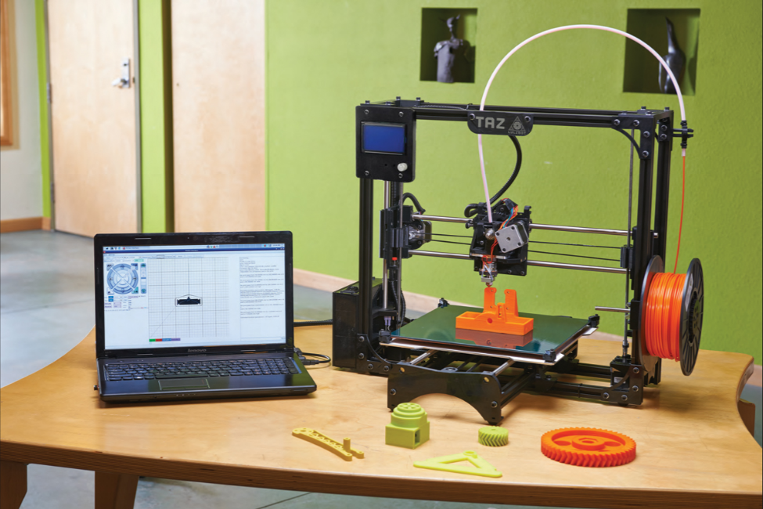
3D Printer
18
Notes:
Widely accessible and affordable, can use anywhere

Slide 19
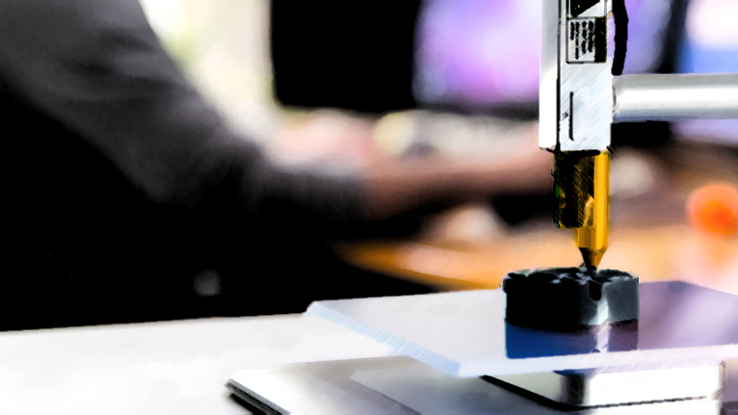

3D Printing Market
$21 Billion by 2020
19

Slide 20
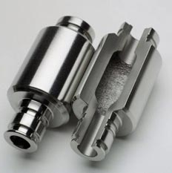
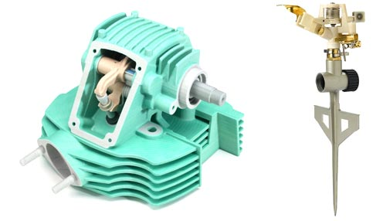
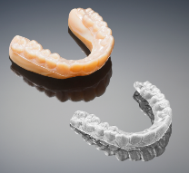
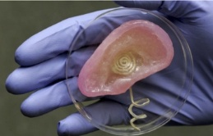
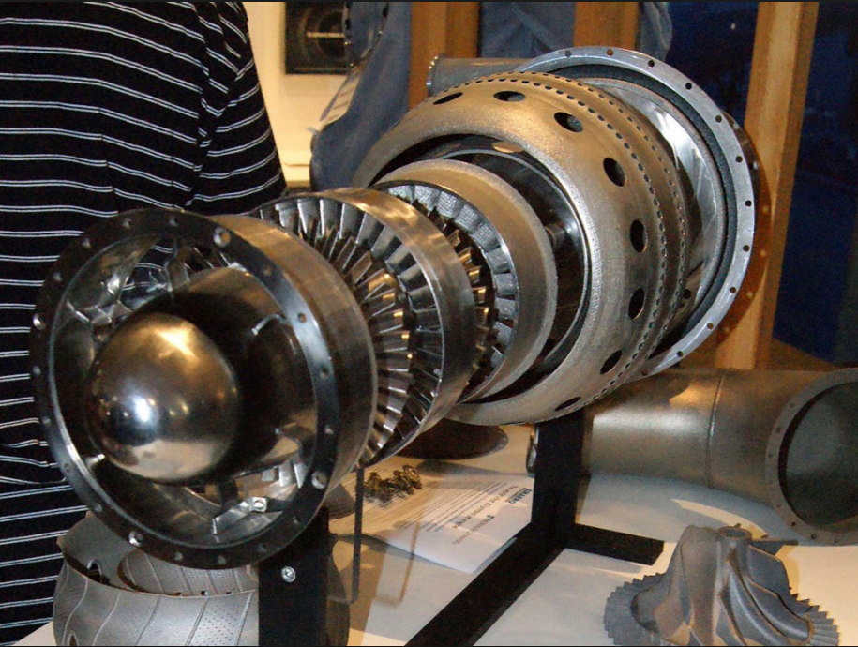
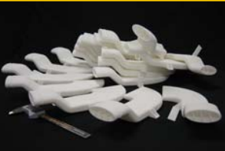
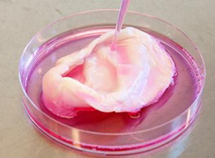
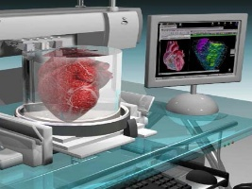
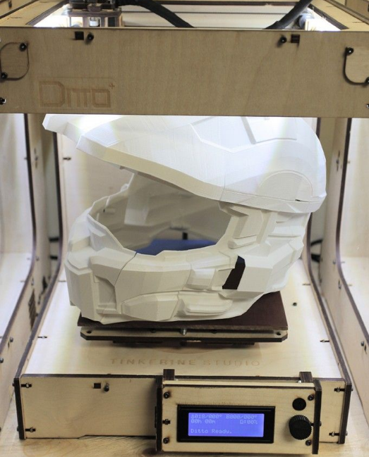
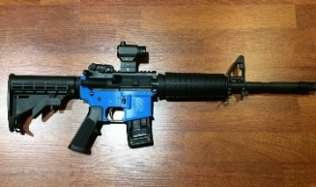
3D Printing Application
3D Printing
Industrial Product
Health-care Tool
Aerospace Unit
Biomedical
Organ
Military Device
Notes:
On the right, high tolerance engine parts were printed using a process called “Electron Beam Melting” and finished with traditional machining processes. While not the norm these uses begin to suggest what is possible in medicine and industry.

Slide 21



3D Printing Application
3D Printing
Industrial Product
Health-care Tool
Aerospace Unit
Biomedical
Organ
Military Device
Notes:
On the right, high tolerance engine parts were printed using a process called “Electron Beam Melting” and finished with traditional machining processes. While not the norm these uses begin to suggest what is possible in medicine and industry.

Slide 22


Is 3D printing system safe from attack?
22

Slide 23
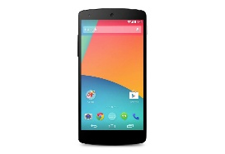
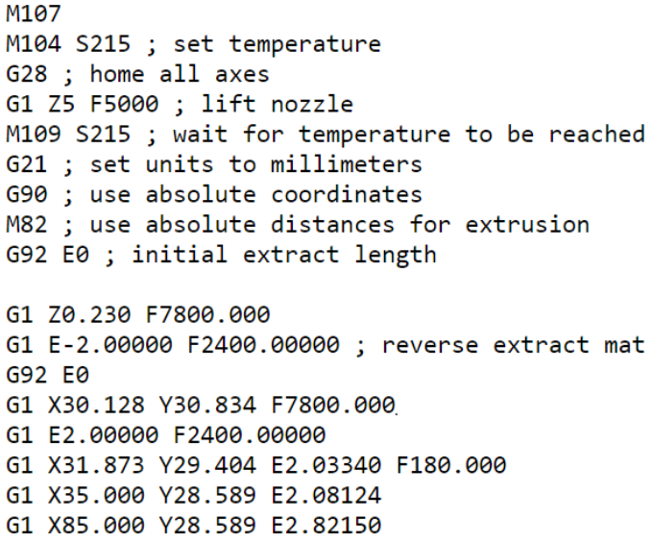
Unobtrusive Side-channel Attack
Distance Physical Attack
IP Design: G-code File
23

Slide 24


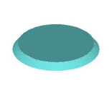
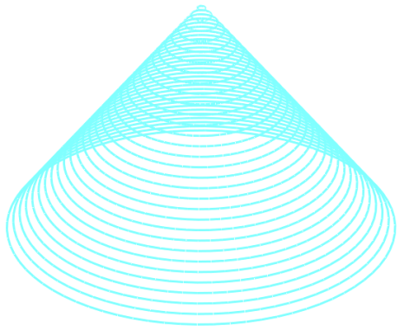


Side-channel Attack Principle
G-code File
Printing Trajectory
Reconstructed G-code File
Predicted Printing Trajectory
24

Slide 25



Our proposed 3D Printer IP Attack
Side-channel Detection
Printing Status Prediction
IP Reconstruction
25

Slide 26


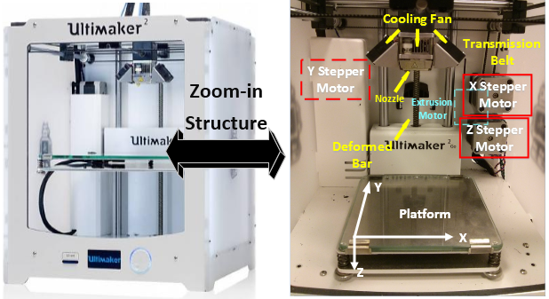
Side Channel Emission
3D Printer Physical Structure
Emitted Side Channels
26

Slide 27
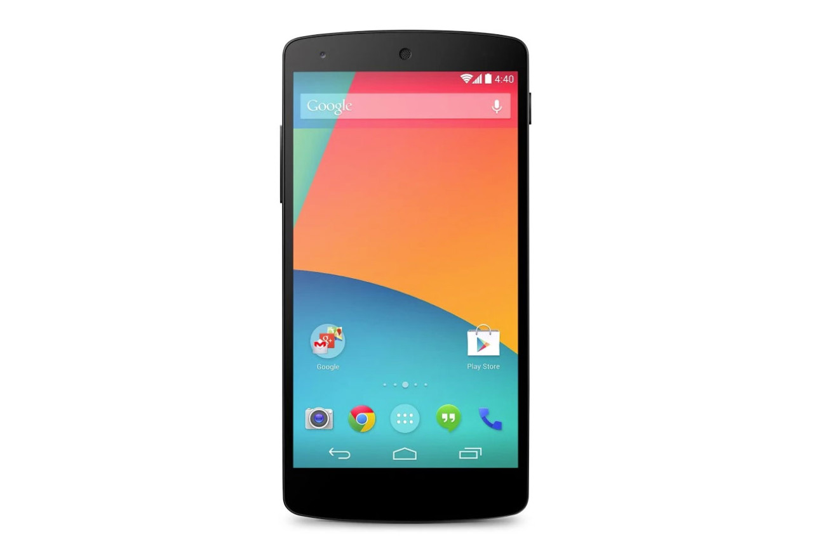
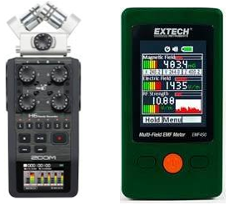
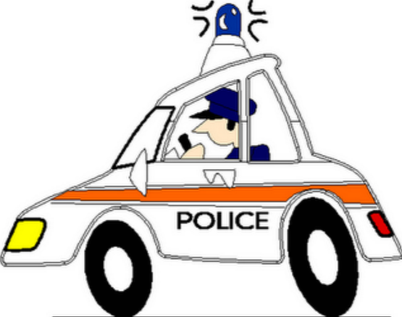
Side Channel Detection
Professional Devices
Magnetometer
Smartphone-based Attack
Most pervasive daily device
Rich on-board sensors
Inconspicuous attack
Zero launching barrier
Microphone
27
Notes:
Prof devices are fairly expensive, hard-to-deploy, and most importantly, too eye-catching (not practical in real attack).

Slide 28
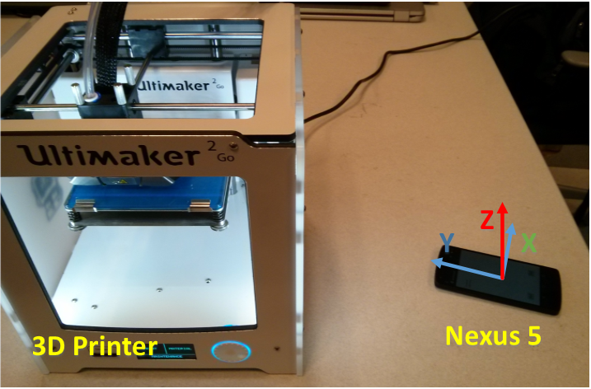
Side Channel Detection
28

Slide 29
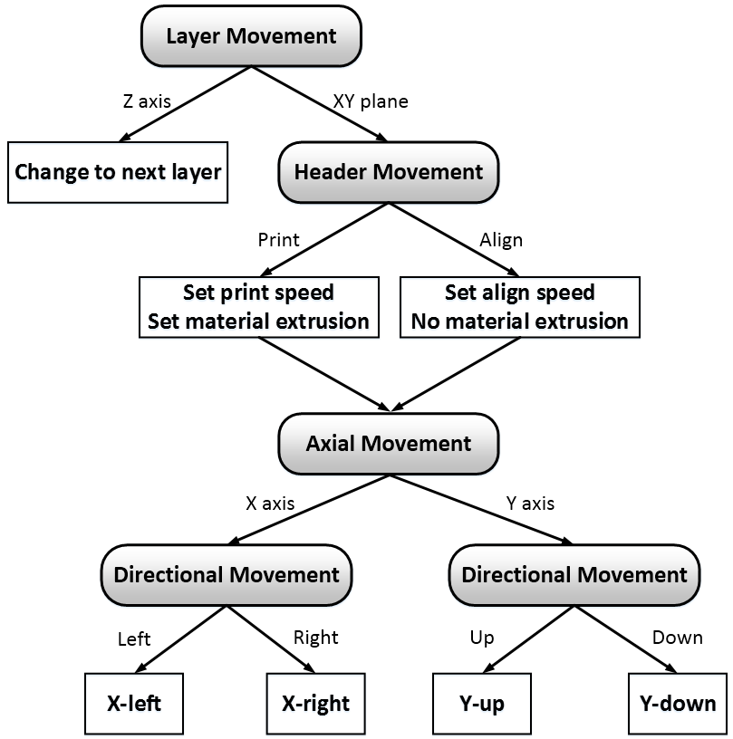
Primitive Operation
Category
Relationship
Layer Movement
Primitive Operation
Header Movement
Axial Movement
Directional Movement
29

Slide 30
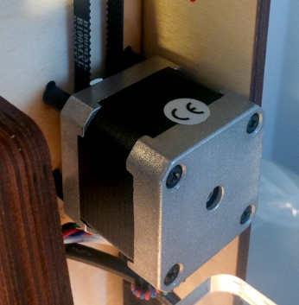
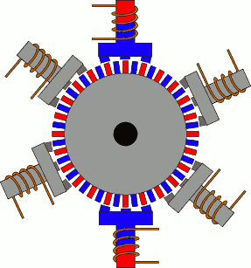
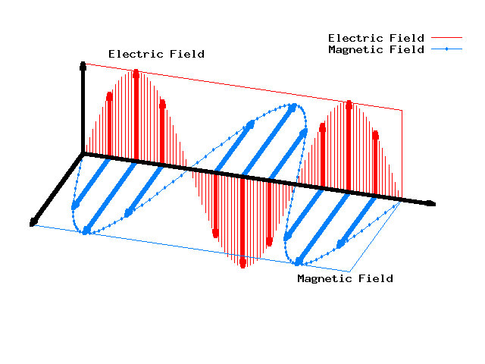
Primitive Operation
Directional Movement Prediction
Stepper Motor
Working Principle
Magnetic Side Channel
Reverse rotation
Reverse side channel
30
Notes:
The structure of the stepper motor: toothed electromagnets and geared-shape rotor.

Slide 31
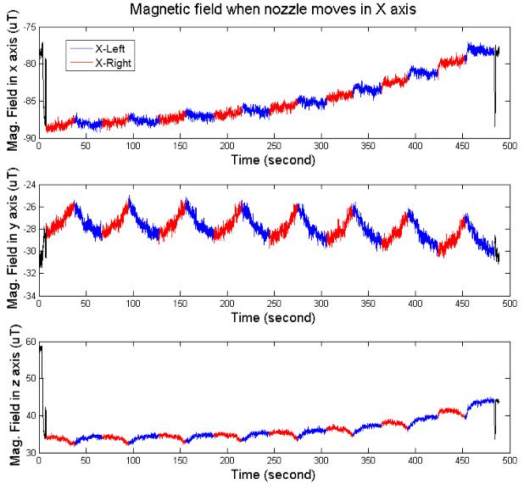
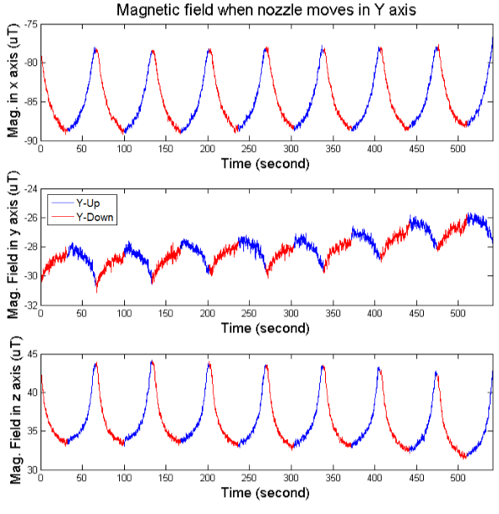
Primitive Operation
Directional Movement Prediction
Detected magnetic side channel in two opposite directions
31

Slide 32
Primitive Operation
Category
Relationship
Layer Movement
Primitive Operation
Header Movement
Axial Movement
Directional Movement
32

Slide 33
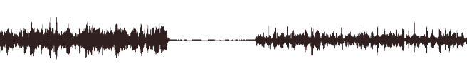
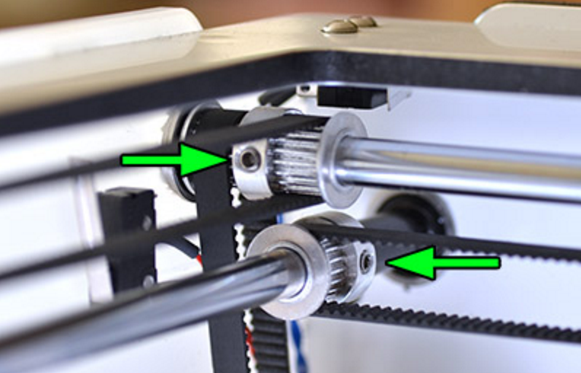
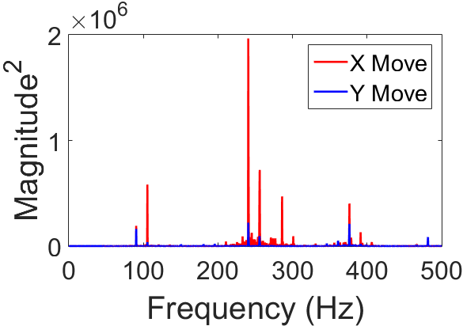
Primitive Operation
Axial Movement Prediction
Separate belt-pulley system
Different acoustic side channel
X Pulley System
X Axial Movement
Y Axial Movement
Y Pulley System
33

Slide 34
Primitive Operation
Category
Relationship
Layer Movement
Primitive Operation
Header Movement
Axial Movement
Directional Movement
34

Slide 35
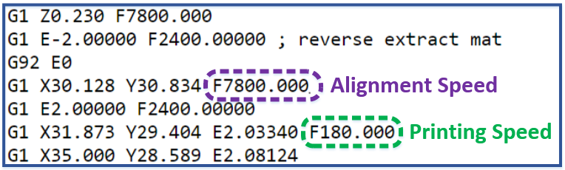
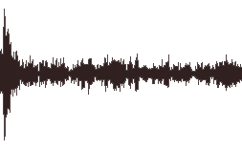
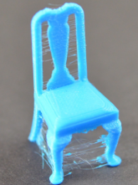
Primitive Operation
Header Movement Prediction
Extremely high align speed to save time and avoid stringing
Much higher amplitude in acoustic side channel
Fast align
Stringing
35

Slide 36
Primitive Operation
Category
Relationship
Layer Movement
Primitive Operation
Header Movement
Axial Movement
Directional Movement
36

Slide 37

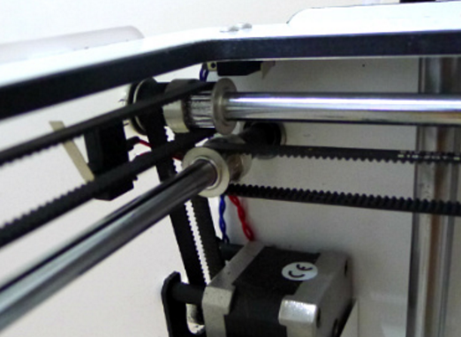
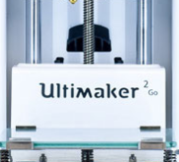

Primitive Operation
Layer Movement Prediction
Different Transmission System for different accuracy control, frequency and work load
Different acoustic side channel
Z movement
Y movement
X movement
X/Y belt-pulley
Z Lead-screw
37

Slide 38


Printing Status Prediction
Frame size
38
Notes:
Click on ‘Temporal/Spectral Features’ and jump to feature list.

Slide 39


Printing Status Prediction
39
Notes:
Click on ‘Printing Status Prediction’ to jump back.

Slide 40

G-code Reconstruction
Predicted Primitive
Predicted Primitive
G-code Protocol
Predicted Primitive
(Algorithm 1)
Printing Status Set
Reconstructed G-code
40
Notes:
Click on ‘Algorithm 1’ and jump to the proposed algorithm.

Slide 41

G-code Reconstruction
41
Notes:
Click on ‘G-code Reconstruction’ to jump back.

Slide 42





Evaluation
Layer Movement Model
Head Movement Model
Axial Movement Model
Average accuracy=94.77%
X Directional Movement Model
Y Directional Movement Model
42

Slide 43

Evaluation
Reconstruction Performance
Complex shape reconstruction
10-layer shape:
Original design
Reconstructed shape
43

Slide 44






Smart voice assistants
44

Slide 45

Inaudible commands
45

Slide 46


Microphones

Slide 47

Low pass filter

Slide 48

Non-linearity

Slide 49

Multiple frequency component

Slide 50

Multiple frequency component

Slide 51

Launching attack

Slide 52
Examples
https://youtu.be/_FrKySibcb8?t=19
https://youtu.be/21HjF4A3WE4?t=5
Inaudible Voice Commands: The Long-Range Attack and Defense. Roy et al. NSDI 2018
DolphinAttack: Inaudible Voice Command. Zhang et al. CCS 2017

Slide 53

Gyrophone: using gyroscope as microphone

Slide 54


Permission for sensors

Slide 55

External sounds impact gyroscopes

Slide 56

Sampling rates

Slide 57


Speech range

Slide 58

Aliasing
Aliasing enables sensing higher frequency components

Slide 59

Experimental setup
https://crypto.stanford.edu/gyrophone/

Slide 60

Evaluations

Slide 61

Gender detection

Slide 62

Speaker identification

Slide 63

Word recognition

Slide 64


Inferring routes through motion sensors
Inferring User Routes and Locations using Zero-Permission Mobile Sensors Sashank Narain , Triet D. Vo-Huu , Kenneth Block‡ and Guevara Noubir. IEEE SP 2016

Slide 65


Tracking subway rides through sensors
We Can Track You If You Take the Metro: Tracking Metro Riders Using Accelerometers on Smartphones. Jingyu Hua, Zhenyu Shen, Sheng Zhong. IEEE Transactions on Information Forensics and Security 2017

Slide 66
Logistics
Final Exam On Nov 19 (9am-11am) on Moodle
More on this next class (also have a review class on Tuesday)
Post questions you want clarification on, in Piazza
Class evaluation (please complete)
http://go.ncsu.edu/cesurvey
Go and fill out the survey after class (requires 2-3 mins)

